Slide 1
Digital Image Processing
Recognition and Classification

Slide 2
Feature Selection
To distinguish objects of different types, characteristics that can produce descriptive parameters should be decided.
The measured quantity of such selection is called Feature.
Proper selection simplifies the problem but improper increases complexity.
Good selection criteria could be: realiable, independent and discriminating, at least if they are useful features.

Slide 3
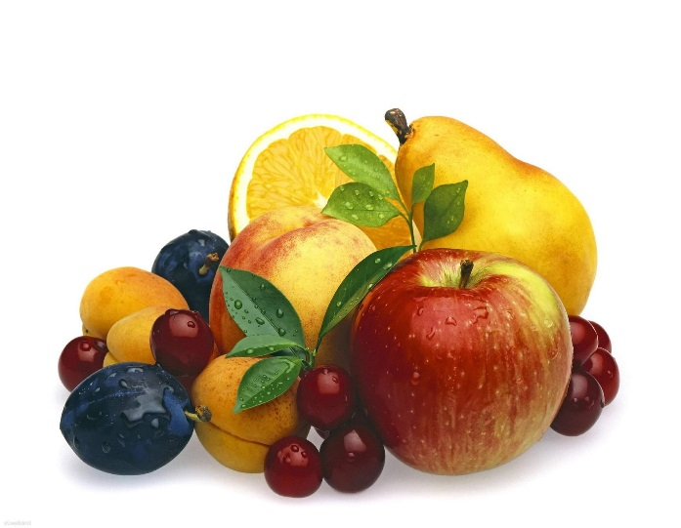
Good Features Characteristics
Discrimination:
Features should take different values for object belonging to different class.
Ex: A diameter could be a good feature to sort the fruits as it takes significantly different values for different fruits like grapes and apples.

Slide 4
Good Features Characteristics
Reliability:
Features should be similar for all objects of the same class.
Ex: Color may be a poor features for apples if they occur in varying degree of redness i.e. green apple and red apple might differ significantly even though they both belong to the class of apples.

Slide 5
Good Features Characteristics
Independence:
Various features in multi-feature system should be uncorrelated with each other.
Ex: weight and diameter would constitute highly correlated features, namely, size of the fruits.
Small in numbers:
More features then more complexity, training and providing weights becomes more difficult.

Slide 6
Classification
Supervised
  Parallelepiped
  Minimum Distance
  Maximum Likelihood
      (Bayes Rule)
    Non parametric
    Parametric
Unsupervised(Clustering)
  K – Means
  ISODATA

Slide 7
Pattern Recognition
Supervised Classification
  Also called as supervised classification
  Can be distributed free or statistical
  Distribution Free methods do not require knowledge of probability distributions
  Statistical techniques are based on probability distribution which can be both parametric as well as non parametric.

Slide 8
Supervised Classification
A Classification Procedure is said to be supervised if user defines decision rules or provides training sets for guiding machine.
General Procedure includes
  Set up a Classification Scheme:
    Be appropriate to the scale and resolution
    Be appropriate to the application
    Include background classes that can be confused with the target classes.

Slide 9
Supervised Classification…
2. Select the features to be used in the classification(Feature Extraction)
  Reduce Redundancy
  Define useful features
3. Characterize the classes in terms of selected features.
4. Determine the parameters (if any) required for the classifier
5. Perform and classification
6. Evaluate the result

Slide 10
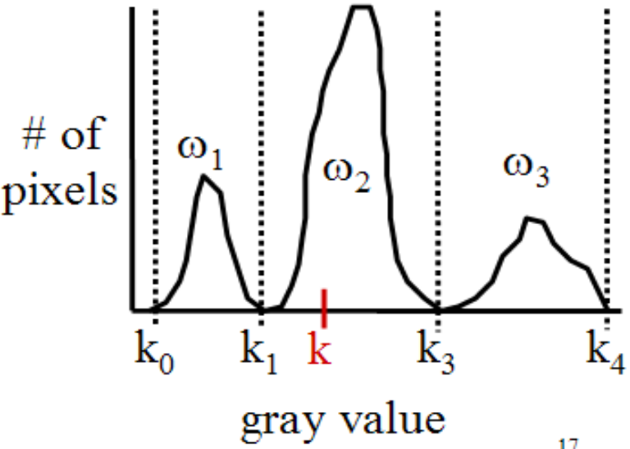
Parallelepiped Classifier
The parallelepiped classifier is essentially a thresholding operation in multiple bands.
The simplest case is with a single variable (1 spectral band) where a pixel is assigned to a particular class if its gray value is less than some minimum and greater that some maximum

Slide 11
Parallelepiped Classification…
Advantages:
  Models data distributions as a rectangle in measurement space.
  Simple to set up
  Easy to understand
  Very fast(Real Time)
Disadvantages
  Actual data distribution
  does not fit rectangular model well.
  For Example:

Slide 12
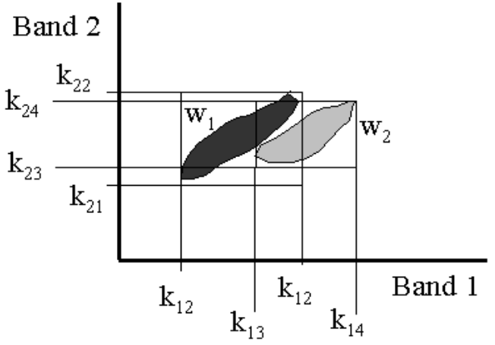
Parallelepiped Classification
Even though the classes do not overlap, the
rectangular boundaries defined by the classifier do overlap.
Within the overlap region the classifier cannot
distinguish between the two classes.
A more powerful and adaptable classification
scheme is needed.

Slide 13
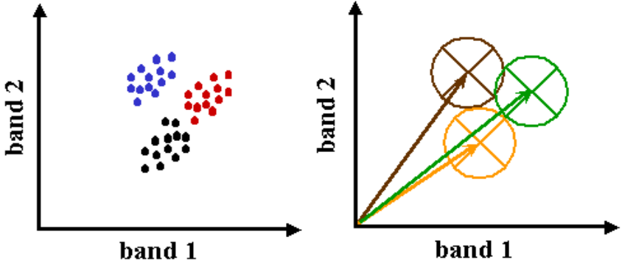
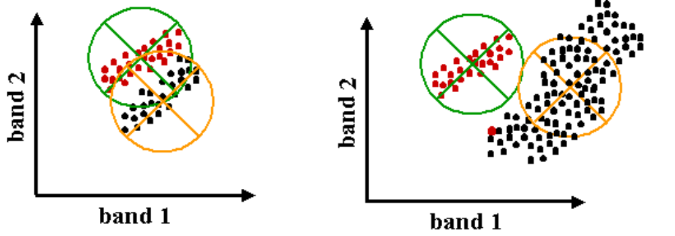
Minimum Distance Classifier
Defines classes in terms of the distance from a prototype vector usually the mean vector from the class.
Discriminate function is defined in terms of distance from the mean: d_{i}(k) = 1/(µ_{i} – k) where µ_{i} is the mean vector for the ith class.

Slide 14
Minimum Distance Classifier…
Advantages
Somewhat better description of distribution.
Disadvantages
Much more computation than for the parallelepiped method.

Slide 15
Maximum Likelihood Classification
General Term which encompasses the most supervised classifiers.
Based on Baye’s theorem.
  P(W/X) = P(X/W)P(W) / P(X)
X = Measurement vector is simply an ordered list of the value (grey value, digital number) of a pixel in each of the image channels. That is, x = (x1, x2, x3, ... , xn)

Slide 16
Maximum Likelihood:Non Parametric Classifiers
Class conditional probability density function P(X/A) is estimated using frequency of measurement vectors in the training data.
Important advantage is that any pattern, however irregular it may be, can be characterized exactly.
Major shortcomings are:
  Difficult to obtain large enough training sample to adequately characterize the PDF.
  Require massive memory or clever programming

Slide 17
Maximum Likelihood:Parametric classifier
Uses a parameterized model to describe the distribution P(x/w).
Functional form generally are well defined, probabilities are completely specified when means, variances, and covariances are present.

Slide 18
Unsupervised Learning
Data do not have target attribute.
Process involves Exploring and finding some intrinsic properties in them.
Technique named clustering is used, a way to find similarity among data.
No priori information is provided as supervised one, so called unsupervised learning.

Slide 19
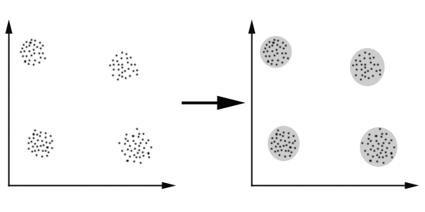
Clustering :An illustration
The data set has four natural groups of data points. i.e. 4 natural clusters.

Slide 20
Why Clustering?
Problem domain:
Grouping of people of similar sizes to make “small”, “medium” and “large” T shirts.
  Tailor made for each person: Too Expensive
  One size fits all? : does not fit all
In marketing, Segment customers according to their similarities.
In fact clustering is one of the most utilized data mining technique. It finds application in medicine, psychology, botany marketing and many more.
In recent years, due to rapid increase of online documents, text clustering becomes important.

Slide 21
K-Means Algorithm
An unsupervised clustering algorithm
“K” stands for number of clusters, it is typically a user input to the algorithm; some criteria can be used to automatically estimate K
K-means algorithm is iterative in nature
It converges, however only a local minimum is obtained
Works only for numerical data
Easy to implement

Slide 22
K-Means Algorithm
Given k, algorithms work as follows:
Randomly choose k data points(seeds) to be the initial centroids, cluster centers.
Assign each data point to the closest centroid.
Re-compute the centroids using the current cluster memberships.
If a convergence criterion is not met, go to 2.

Slide 23
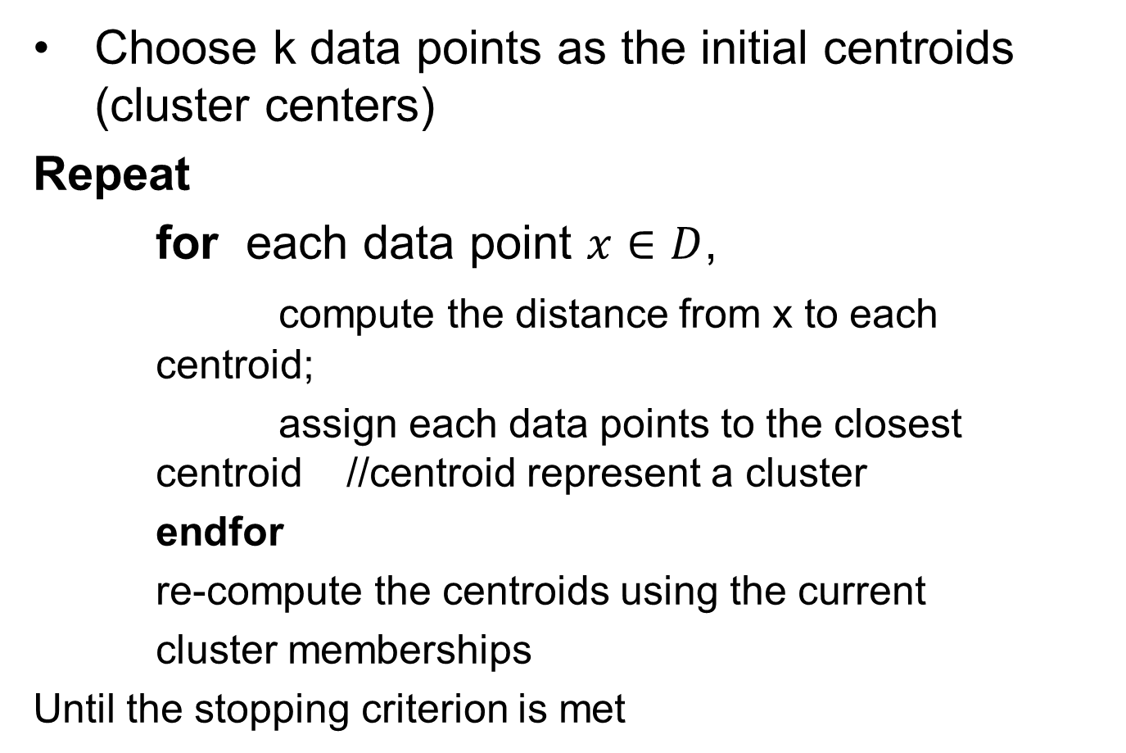
K-Means Algorithm

Slide 24
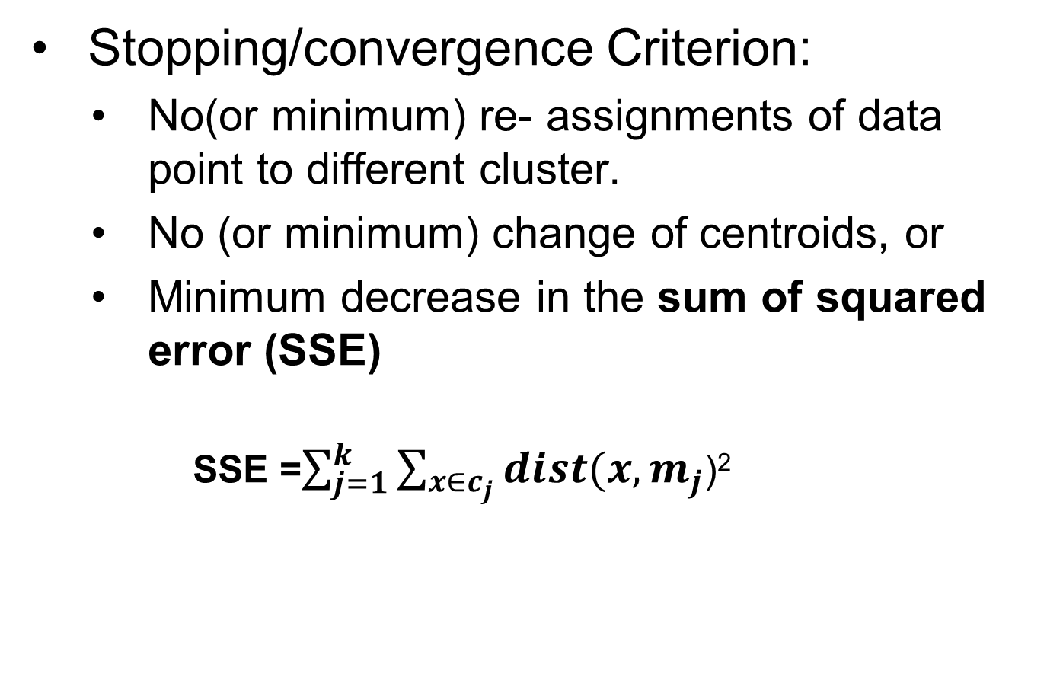
K-Means Algorithm

Slide 25

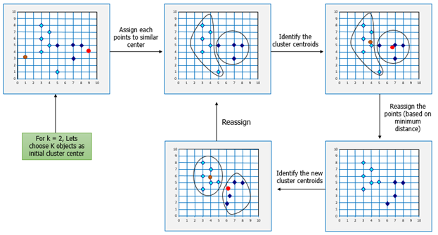
K-Means Example

Slide 26
Pros and Cons of K means
Strengths:
Simple : easy to understand and to implement
Efficient : Time Complexity: O(tkn) where n is the number of data points, k is the number of clusters, and t is the number of iterations.
since both t and k are small, k-means is considered a linear algorithm, k means is most popular clustering algorithm.

Slide 27
Pros and Cons of K means
Weakness of K-Means
The algorithm is only applicable if the mean is defined. Generally, k-mode the centroid is represented by most frequent values.
Sensitive to outliers. Outliers are the data points that are very far away from other data points. It could be error in the data recording or some special data points with very different values.

Slide 28
Pros and Cons of K means
Weakness of K-Means
The algorithm is only applicable if the mean is defined. Generally, k-mode the centroid is represented by most frequent values.
Sensitive to outliers. Outliers are the data points that are very far away from other data points. It could be error in the data recording or some special data points with very different values.

Slide 29
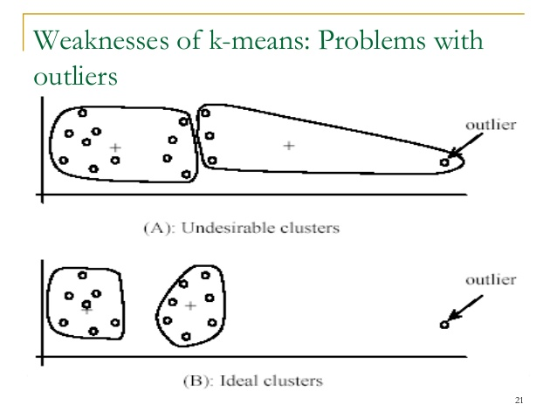
Pros and Cons of K means
Weakness of K-Means

Slide 30
ISODATA
ISODATA unsupervised classification calculates class means evenly distributed in the data space then iteratively clusters the remaining pixels using minimum distance techniques. Each iteration recalculates means and reclassifies pixels with respect to the new means. Iterative class splitting, merging, and deleting is done based on input threshold parameters. All pixels are classified to the nearest class unless a standard deviation or distance threshold is specified, in which case some pixels may be unclassified if they do not meet the selected criteria. This process continues until the number of pixels in each class changes by less than the selected pixel change threshold or the maximum number of iterations is reached

Slide 31
Thank You

